Slide 1
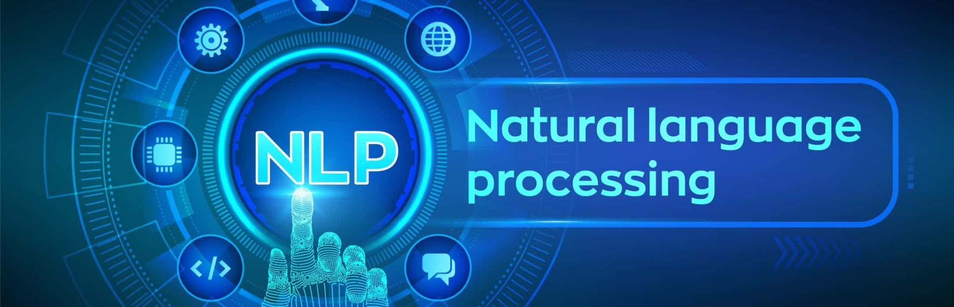
Data 606 Capstone Project: NPR Speaker Identification with Text Data
Reed Balentine, Khiran Kumar, Daniel Thang
Notes:
Hello

Slide 2
Purpose
Purpose: Build a machine learning model that can reliably predict who the speaker is for lines of dialogue from NPR Radio Transcripts.
Due to the messy nature of text, analyzing and organizing is time-consuming, so most companies fail to use it to its full potential.
Vital practice for automating business processes and making data-driven business decisions.
Notes:
Khiran
The purpose of our project is to Build a machine learning model that can reliably predict who the speaker is for lines of dialogue from NPR Radio Transcripts. Being able to automate the process of identification through the patterns of text data is a difficult task but it is a great way to analyze text data to its full potential since the methods used can be applied to other text data that is probably more structured than media transcripts, so their accuracy will be much higher.

Slide 3
NPR Main Dataset - utterances.csv
Original Data: total of 3,199,858 rows and 4 columns
562 rows with missing utterance data
184,423 rows of _NO_SPEAKER (mostly soundbites)
Speaker column has a lot of different variations of the same name
host-id.json will be used for attaching ids to each utterance of the host to use as a target variable
Data after attaching host-map: total of 1,174,823 rows and 6 columns
Notes:
Daniel
Talk about the simple cleaning of parsing and capitalization done in order to match the string of the host-id. We will focus on the speaker column and utterance column.

Slide 4
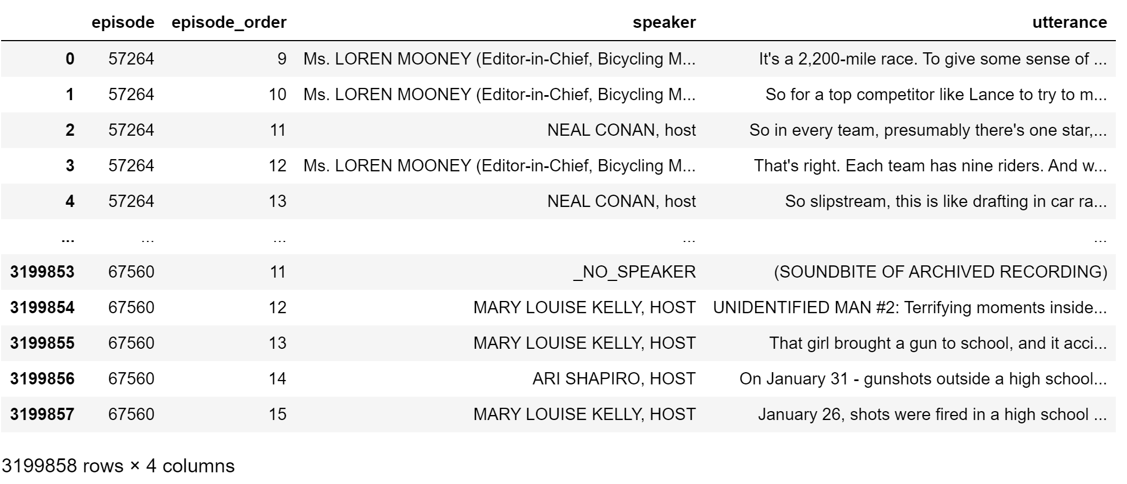
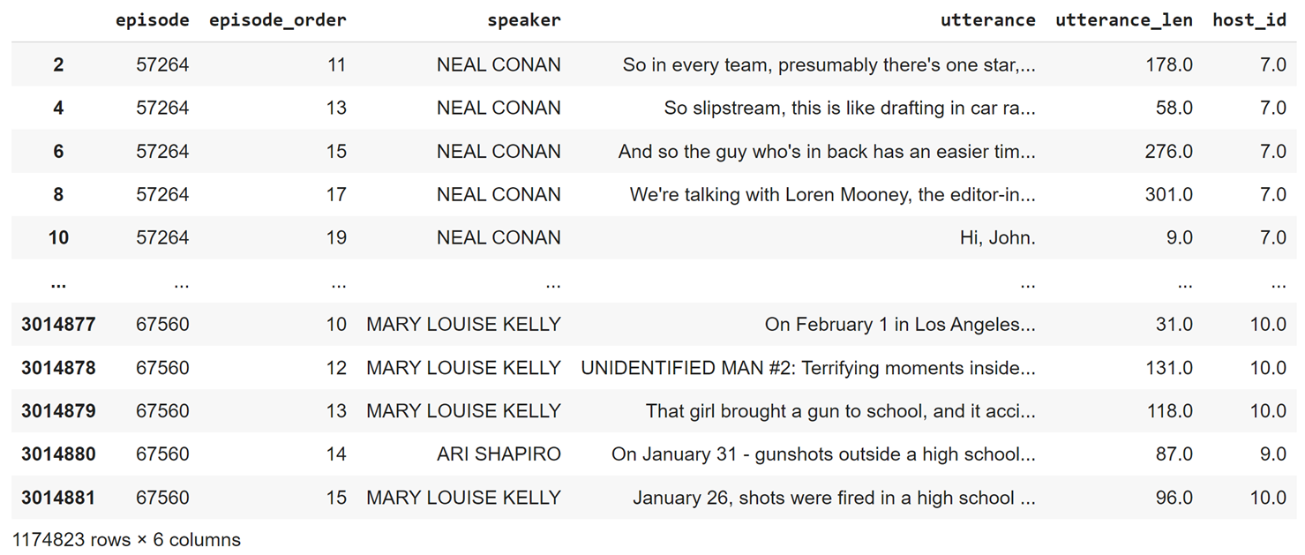
Before vs After
Notes:
Daniel

Slide 5
NPR Dataset Cleaning
Cleaning the “utterance” column
Only keep rows with more than or equal to 100 characters in the utterance.
Only keep speakers with more than 30,000 counts (Top 4 Speakers: NEAL CONAN-126971, STEVE INSKEEP-33787, ROBERT SIEGEL-29948, IRA FLATOW-29888)
Limit the sample size of NEAL CONAN to 34,000, to avoid the result being skewed.
Make the utterance string into lower-case
Drop any rows if the string in the utterance column starts with “undefined”, because it means that the host/speaker is not the person saying the line.
Notes:
Daniel
**Explain the cleaning process following the slide**
So, we only limited the speaker to the top 4 speaker because it was taking so long for the large data to be processed. But for later phases, we want to keep at least the top 10 speaker.

Slide 6
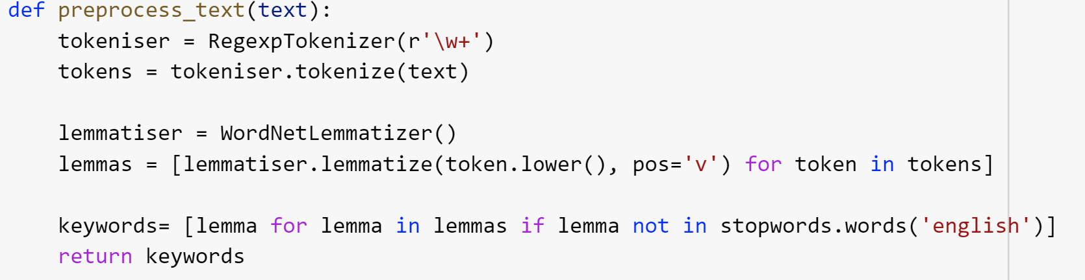
NPR Dataset Processing
Notes:
REED
For processing we are using NLTK’s library.
We are using RegexpTokenizer to splits a string using a regular expression, which matches either the tokens or the separators between tokens. “\w+” means any word character.
We use the WordNetLemmatizer, which is the process of grouping together the different inflected forms of a word so they can be analyzed as a single item, so here it will return the input word unchanged if it cannot be found in WordNet.
We are also using stopwords, which are commonly used word (such as “the”, “a”, “an”, “in”) that a search engine has been programmed to ignore, both when indexing entries for searching and when retrieving them as the result of a search query.

Slide 7
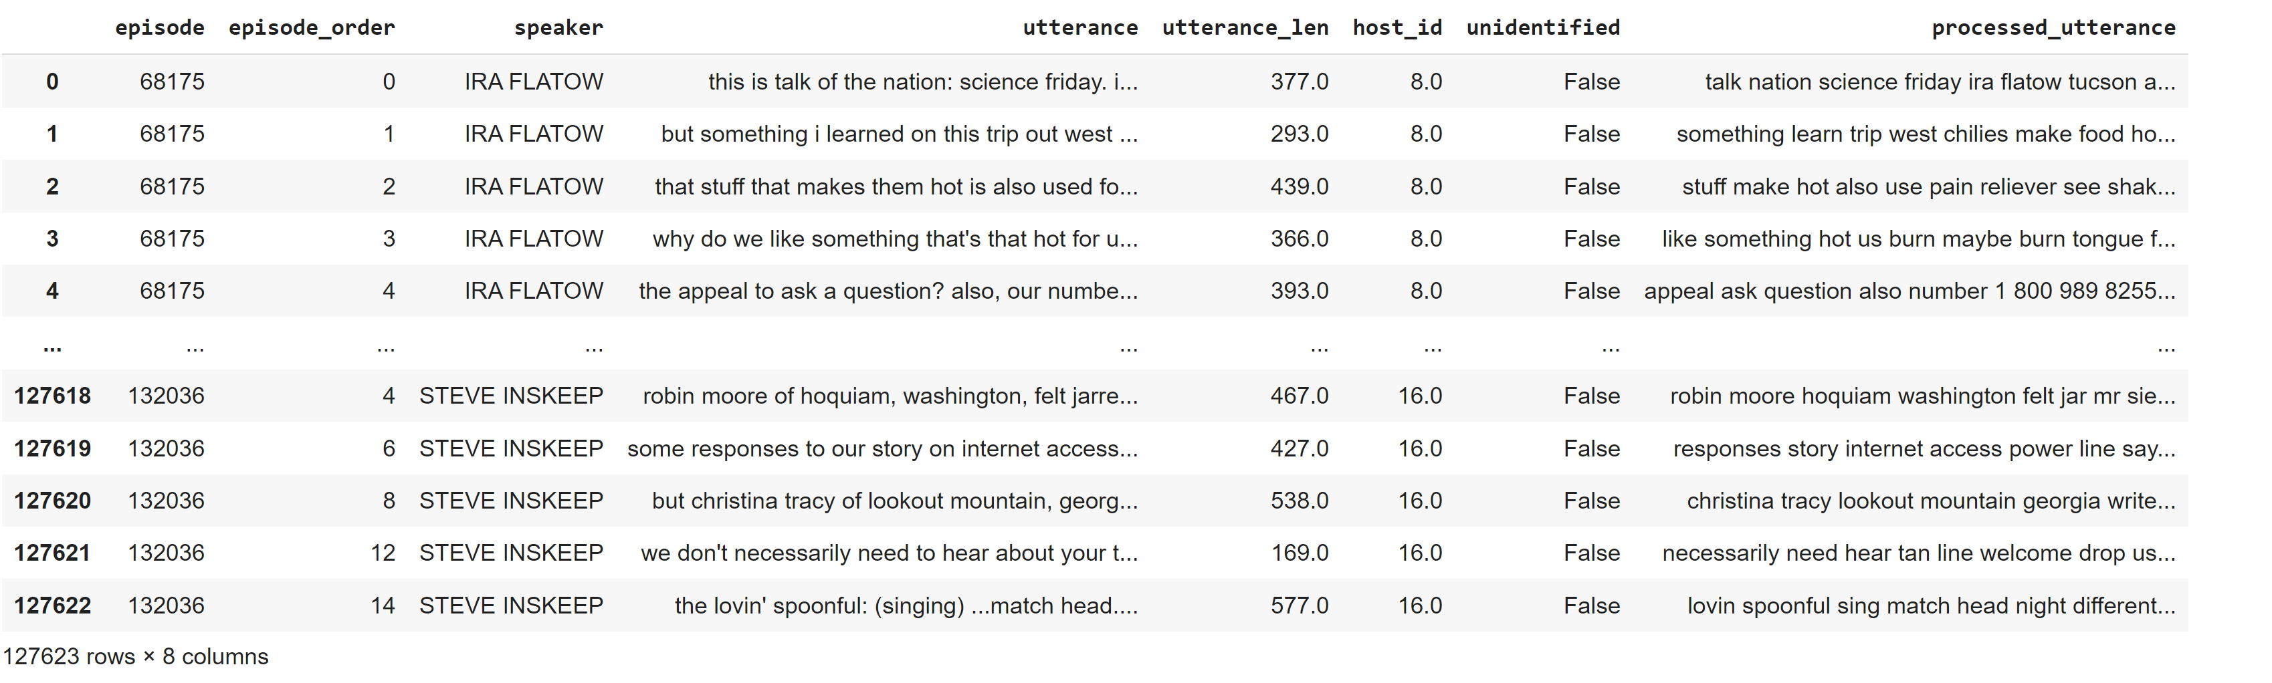
NPR Dataset Processing: Final DF
Notes:
REED
This is final data frame we will use after cleaning and adding a few processors.

Slide 8
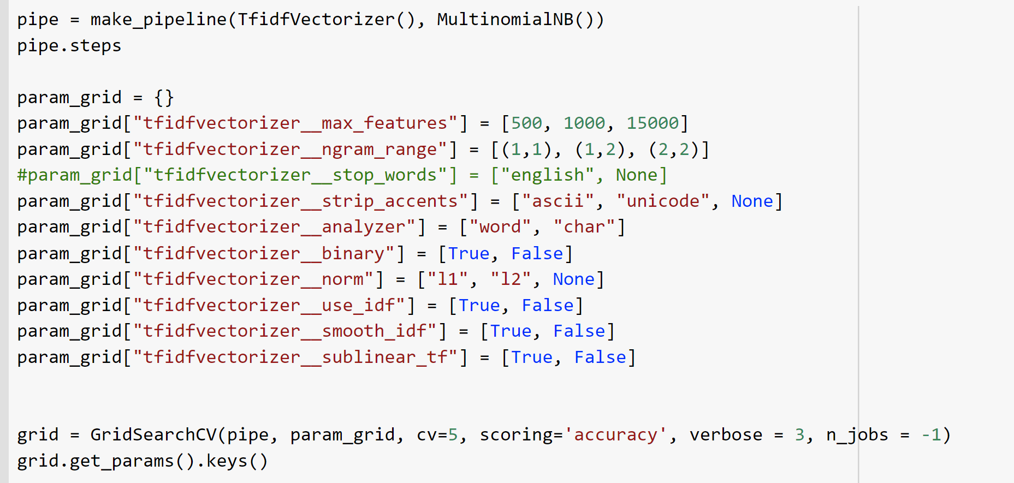
NPR Dataset Processing: Pipelines
Notes:
REED
Here we are making the pipelines and using TDIF vectorizers and GridSearchCV to find the best parameters to use for modeling. As of right now, this pipeline is running for way too long, so we skipped this step for now and just used commons parameters for the modeling part.

Slide 9
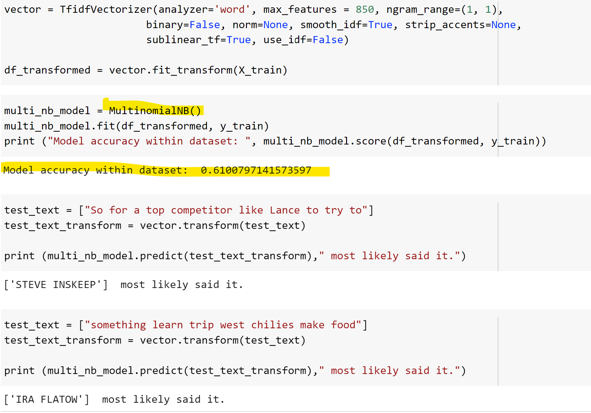
NPR Dataset Processing: Modeling and Evaluating
Notes:
Khiran
So, as we said we used common parameters and used Multinomial Naive Bayes. It is useful for classification with discreate features, so here in text learning, the count of each word is used to to predict the class or label. We got a model accuracy of 0.61, and I think this is good for starting point as we did not even use the best parameters for modeling just yet. For evaluation, we tested out the model by allowing it to predict who the speaker is based on the given text, and it was both correct for the two test.
We only used one model for now due to time and space issues. We will use more models like SVM, KNN, or Random Forest, and RNN after we are satisfied with the processing aspects and also getting the best parameters. We want to do a few more testing and try to increase accuracy and then run more models.

Slide 10
How can we increase the model accuracy????

Slide 11

Thank you, Any Questions?

